Slide 1
ABBYY FLEXICAPTURE
SYSTEM ARCHITECTURE

Slide 2

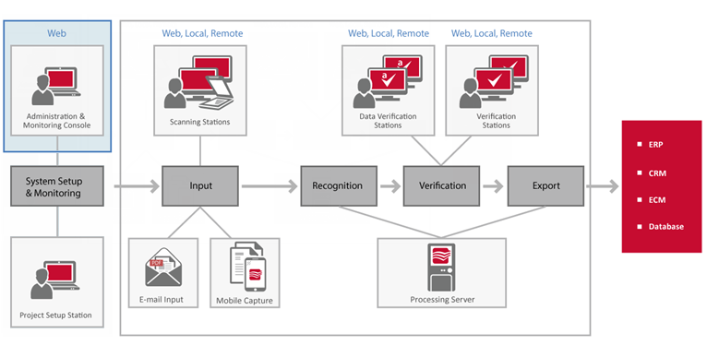


ABBYY FlexiCapture Workflow Design
Load balancing and multi-operators tasks
Scalability – Performance - Stability
OCR Processing of all document types

Slide 3
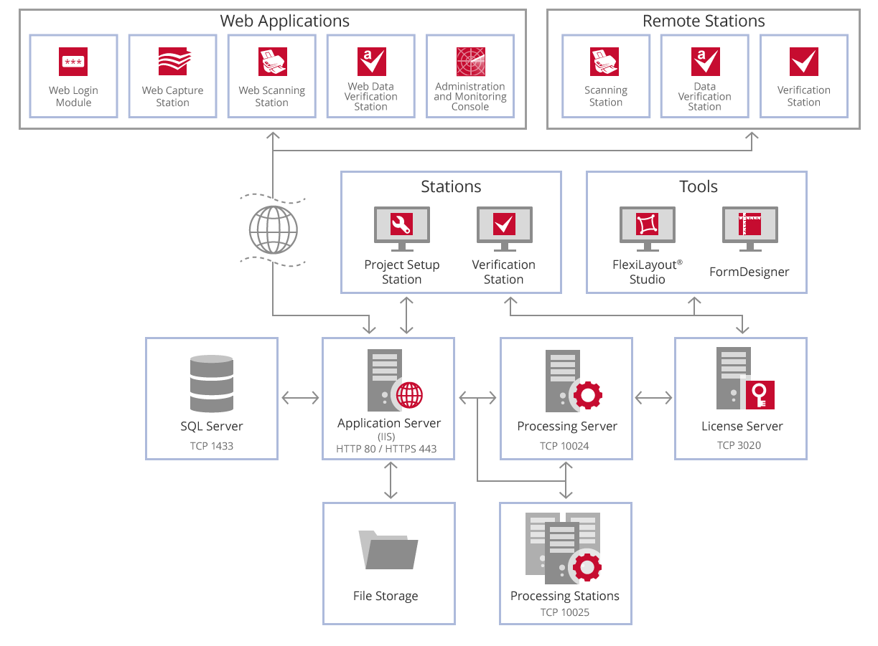
Component Interaction of ABBYY FlexiCapture Distributed
Ports should be enabled:
Application Server— 80 if HTTP is used or 443 if HTTPS is used
Processing Server — 10024
Licensing Server — 3020
Processing Station — 10025
Notes:
This flow chart illustrates interaction among the ABBYY FlexiCapture components.

